Slide 1
Software Quality Assurance and Testing
Harish Aggarwal

Slide 2
Essential SQA:
Processes and Success Factors

Slide 3
Agenda
Definition
Quality Assurance Vs Quality Control
Business Models
Cost of Quality
Quality culture
Success Factors

Slide 4
Software - Definition
Development Life Cycle
Software life cycle is process that contains the activities of requirements analysis, design, coding, integration, testing, installation, and support for acceptance of software products. ISO 12207 [ISO 17]

Slide 5
Software Quality Definition
Software Quality
Conformance to established software requirements; the capability of a software product to satisfy stated and implied needs when used under specified conditions (ISO 25010 [ISO 11i]).
The degree to which a software product meets established requirements; however, quality depends upon the degree to which those established requirements accurately represent stakeholder needs, wants, and expectations [(IEEE 730)] [IEE 14].
(Needs, Wants, Expectations can include - Functionalities, performance, efficiency, accurate results, reliability, usability, costs, deadlines, etc.)
(True needs, Expressed needs, Specified needs, Achieved needs)

Slide 6
Software Quality Assurance
Definition
Software Quality Assurance
The systematic application of scientific and technological knowledge, methods, and experience for the design, implementation, testing, and documentation of software. ISO 24765 [ISO 17a]
A set of activities that define and assess the adequacy of software processes to provide evidence that establishes confidence that the software processes are appropriate for and produce software products of suitable quality for their intended purposes. A key attribute of SQA is the objectivity of the SQA function with respect to the project. The SQA function may also be organizationally independent of the project; that is, free from technical, managerial, and financial pressures from the project.
[(IEEE 730)]

Slide 7
QA Vs QC
Quality Assurance (QA) refers to process management activities which are aimed at reducing defects and errors for the end customer. QA involves looking at how the processes are performed and making sure that the quality requirements are being fulfilled.
It is a proactive, process-based approach which aims to manage the quality of a product before and during the production process.
Quality control (QC) is concerned with the end product and seeks to ensure that it is not defective or damaged before reaching the customer.
QC is a reactive process which is employed after the product has been created to verify its quality.

Slide 8
QA Vs Testing
Software Quality Assurance
It is the process of ensuring that the software meets the set standards of quality.
Software Testing
It is the process of identifying and verifying that software applications or programs will meet the user's requirements.
Both processes are essential for delivering a high-quality product

Slide 9
QA Vs Testing
 | Quality Assurance | Testing
Definition | A way to prevent mistakes and defects in the manufactured products. | The process of executing a system with the intent of finding defects.
Objective | To improve development and test processes to prevent defects from arising when the product is being developed. | To identify bugs and defects in the software.
Focus | Focuses on improving and optimizing the processes involved in the software development lifecycle. | Centers on verifying that the system meets specified requirements and finding bugs and issues.
Scope | Covers the entire software development process. | Limited to the testing phase of the software development lifecycle.
Activities Involved | Involves process management, setting quality objectives, and process optimization. | Involves test case execution, bug reporting, and ensuring that the software behaves as expected.
Responsibility | Quality Assurance teams should ensure that processes are effective and efficient as per quality standards. | Software testers are responsible for executing test cases and reporting defects.
Outcome | Ensures that the best practices and standards are followed throughout the software development lifecycle. | Ensures that the software is bug-free and works as expected.
Tools Used | Utilizes tools for process monitoring, project management, and process documentation. | Utilizes tools designed for test case management, bug tracking, and test automation.
Timing | Ongoing throughout the software development lifecycle. | Performed after the software is developed and before it is released.

Slide 10
Why QA is important
Reduces Cost and Saves time
Maintains Quality of the Product
Ensures that product is Secure
Improves accessibility and usability
Improves Performance
Increases customer satisfaction
Protects company’s Reputation

Slide 11
Risks of neglecting QA
Software Development Risks
Undetected code errors and Bugs
System misbehaviors
Poor system security
Unstable performance
Business Risk
Missed deadlines
Financial losses
Reputational damage
Unsatisfied customer

Slide 12
Software Components
Overall software quality can be achieved if quality of every component of software is achieved.
Thus it is important to know the components of Software –
Programs – The instruction that have been translated into source code
Procedures – User procedures and other processes
Rules – Business Rules
Documentation – Design Docs, Test Cases, User Manual, etc
Data – Information that is inventoried, modeled, created.

Slide 13
Causes of Software Defect
Popular error-cause categories:
Problems with defining requirements
Lack of effective communication between client and developer
Deviations from specifications
Architecture and design errors
Coding errors (including test code)
Non-compliance with current processes/procedures
Inadequate reviews and tests
Documentation errors
Caused by –
Clients, Analysts, Designers, Software engineers, Testers, or Users.

Slide 14
Causes of Software Defect
Problems with defining requirements
Good requirements are - Correct, complete, clear for each stakeholder group (e.g., the client, the system architect, testers, etc), unambiguous, concise (simple, precise), consistent, feasible (realistic, possible), necessary, independent of the design, independent of the implementation, verifiable and testable, can be traced back to a business need, unique.
Lack of effective communication between client and developer
Poor documentation, ineffective change management process, etc.
Deviations from specifications
Reuse of existing code, trimming of partial requirements, etc.
Architecture and design errors
Incomplete overview of S/W to be developed, incorrect business or technical process sequence, poor design of business or process rule criteria.

Slide 15
Causes of Software Defect
Coding errors (including test code)
Inappropriate choice of programming language and conventions
Poor understanding/interpretation of design documents
Incoherent abstractions, Boundary condition errors.
Non-compliance with current processes/procedures
Non-compliance of Organizations internal methodology including processes, procedures, steps, deliverables, templates, and standards (coding standard).
Inadequate reviews and tests
Design review, code review, Test plan and Test case review.
Documentation errors
Incomplete, obsolete, outdated documentation.

Slide 16
S/W delivery Issues
Issues faced by S/W developers (Organization) :
Incorrect results
Exceeding budget
Penalties for late delivery
Legal Proceedings - Not delivering what the client asked for
Missing Market Opportunity
Bad Reviews in Press
High level of Support calls
Tarnishing reputation of the organization.

Slide 17
S/W delivery
Assumptions and Practices
Assumptions and facts for S/W Delivery -
Delivery on schedule and within budget is crucial
Reliable, correct software is crucial
Requirements must be known and detailed from the project onset
Projects are typically large scale with many communication channels
It is necessary to show that what was promised has indeed been delivered
Plans must be developed, and regular progress reports prepared (which are sent to project management and the client).
Practices to be Followed -
Lots of documentation
Practices followed in Estimating and Management
Waterfall development Cycle
Project Audits

Slide 18
Business Models in S/W
Custom systems written on contract
Accenture, TATA, and Infosys.
Custom software written in-house : To improve organizational efficiency
Internal IT organization.
Commercial software: B2B
e.g., Oracle and SAP.
Mass-market software: B2C
e.g., Microsoft and Adobe.
Commercial and mass-market firmware: Embedded hardware and systems
e.g. Digital cameras, automobile, braking system, and airplane engines.

Slide 19
Business Models in S/W
Factors in each Business Model
Criticality
Uncertainty of users’ wants and needs
Range of environments
Cost of fixing errors
Regulations
Project size
Communication
Concurrent developer–developer communication:
Developer–maintainer communication
Communication between managers and developers
Organization’s culture –
Control culture,
Skill culture,
Collaborative culture,
Thriving culture

Slide 20
Business Models in S/W
Contd.
Open-Source Software: Distributed with its source code and the authorization to modify and distribute it freely under the condition that it is also provided as open-source software once modified.
Concerns
Undemonstrated quality
Lack of support
Delays in providing fixes

Slide 21
Software Cost
Cost of Project can be grouped into following buckets
Implementation costs
Prevention Costs
Appraisal Costs (Testing)
Costs associated with failures or anomalies.
If implementation is 100% correct, the cost of the project is implementation cost and there is no need to incur any cost for quality.

Slide 22
Software Quality Cost
Cost of Software Quality
Prevention Costs
Training to Employees in implementation, review, etc.
Better processes. Setting quality goals, standards, thresholds.
Cost of better tools and technology used for implementation
Appraisal Costs
Testing cost (Verification and validation)
Cost for Testing tools and technologies
Failures Cost
Internal – During development - Rework, Redesign.
External – At Client’s premises.
Replacement cost.
Managing Disputes.
Warranty claims, Loss of reputation.
Need to settle at Optimal cost and optimal quality
Costs ↓ / Quality → | Low | High
Prevention Costs | Low | High
Appraisal Costs | Low | High
Failures Cost | High | Low
Warranty claims, Loss of reputation | High | Low

Slide 23
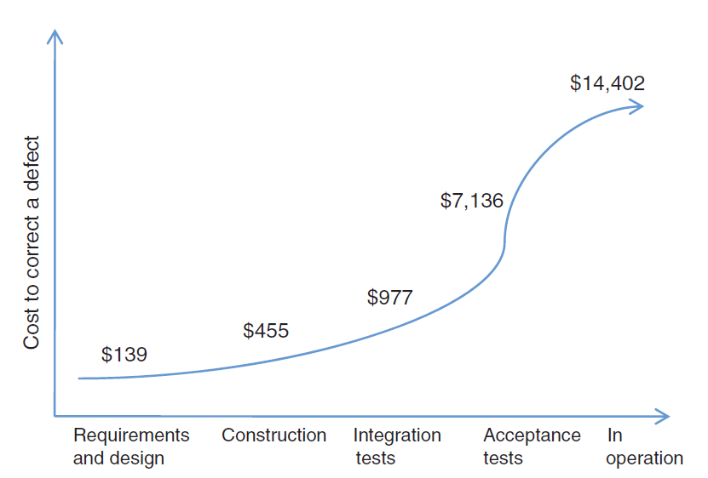
Software Quality Cost
Cost of Fixing Defect
Cost of Propagating an Error
[Src - Caper Jones]

Slide 24
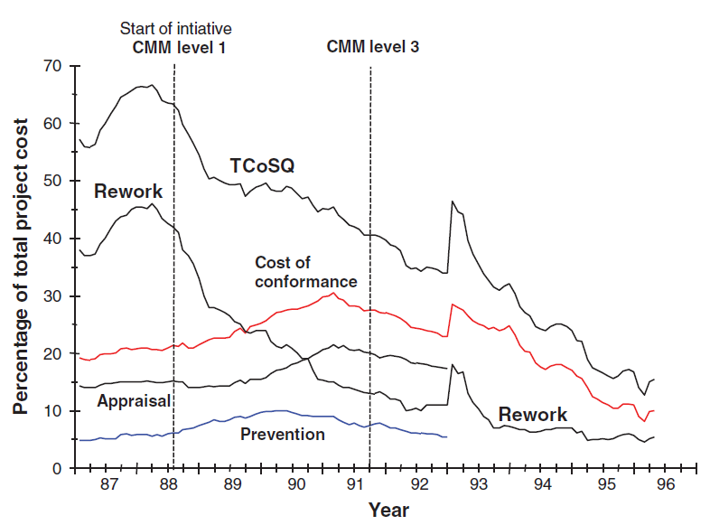
Software Quality Cost
Cost of Software Quality
[HAL-96]

Slide 25
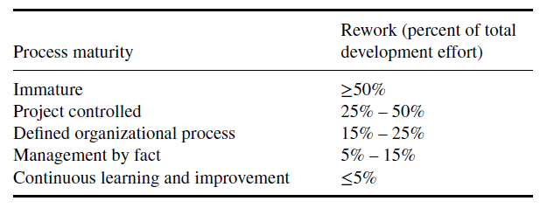
Software Quality Cost
Relationship Between the Process Maturity Characteristic
and Rework [KRA 98]

Slide 26
Quality Culture
Cultural Principles in Software Engineering
Do not compromise quality due to cost or deadlines. Quality is the number one priority.
Quality Work is appreciated.
Continuing education and learning.
Participation of the client in S/W development process.
Share the vision of the final product with the client.
Continuous improvement in your software development process.
Ensure that it is a peer, not a client, who finds the defect.
Repeatedly go through all development steps except coding. coding should only be done once.
Controlling error reports and change requests is essential to quality and maintenance.
If you measure what you do, you can learn to do it better.
Not everything can be changed, Identify and work on changes that will reap the most benefits

Slide 27
Software Culture
The Eight Principles of the IEEE’s Software Engineering Code of Ethics [IEE 99]
S. No. | Principle | Description
1 | The public | Software engineers shall act consistently with the public interest.
2 | Client and Employer | Software engineers shall act in a manner that is in the best interests of their client and employer, consistent with the public interest.
3 | Product | Product Software engineers shall ensure that their products and related modifications meet the highest professional standards possible.
4 | Judgment | Software engineers shall maintain integrity and independence in their professional judgment.
5 | Management | Software engineering managers and leaders shall subscribe to and promote an ethical approach to the management of software development and maintenance.
6 | Profession | Software engineers shall advance the integrity and reputation of the profession consistent with the public interest.
7 | Colleagues | Software engineers shall be fair to and supportive of their colleagues.
8 | Self | Software engineers shall participate in lifelong learning regarding the practice of their profession and shall promote an ethical approach to the practice of the profession.

Slide 28
Factors that Foster Software Quality
Good team spirit.
The skills of the members in the organization – Competency of Team
Managers who set a good example.
Effective communication between colleagues, managers, and the client.
Recognizing and valuing initiatives to improve quality.
Highlighting the notion of organizational culture of guaranteeing quality.
Including the notion of culture in an organization’s strategy.
Common goals and perception about quality between managers, software engineer and other members of the organization.
Client involvement throughout the project. Early clarity of requirements and removal of ambiguities.
Clearly defined roles and responsibilities.

Slide 29
Factors that Foster Software Quality
Allocating the necessary budgets.
SQA techniques adapted to the environment.
Clear terminology with regards to software problems.
An understanding and specific attention to each major category of software error sources.
An awareness of the SQA body of knowledge of the SWEBOK as a guide for SQA
Good understanding of non-functional quality.
Good process for defining, following up, and communicating quality requirements.
Evaluating quality throughout the life cycle of the software.
Establishing software criticality before starting a project.
Using the benefits of software traceability.

Slide 30
Factors that adversely affect Software Quality
Give employees the responsibility but not the authority to take the actions necessary to ensure the project’s success.
When we “shoot the messenger.”
When managers hide their heads in the sand rather than solve problems.
Lack of knowledge in quality assurance.
Unrealistic time frames.
A lack of common working methodology between team members.
A manager who says yes to everyone
Not taking quality requirements into account.
Not taking software criticality into account.
Making excuses to not be concerned with quality.

Slide 31
Factors that adversely affect Software Quality
A lack of cohesion between SQA techniques and environmental factors in organization.
Confusing terminology used to describe software problems.
A lack of understanding or interest for collecting information on software error sources.
Poor understanding of software quality fundamentals.
Ignorance or non-adherence with published SQA techniques.

